Slide 1


Kustomize&helm3

Slide 2
Kustomize & Helm3
Helm v3 solves this issue using a template approach. You just write all your Kubernetes resource definitions as usual. As soon as you realize that some specific part in them needs to be different in deployment A and B, you can add a placeholder and let Helm replace it with a user provided value at installation time. That’s all!
Kustomize tries to achieve the same goal using a polymorphic inheritance approach, combined with a domain-specific language for post-processing (patches). This means that your file which specifies the staging deployment of your microservice will usually inherit from the ‘generic’ microservice description, and then add customization and patches to that using its custom configuration language.

Slide 3
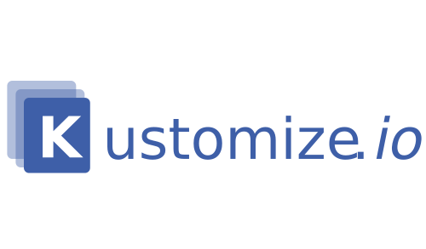
kustomize
Raw, template-free YAML
No original file injection
Runtime patch
Config & Secret generation

Slide 4
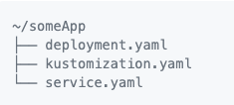
kustomize
kustomize build ~/someApp
kustomize build ~/someApp | kubectl apply -f –
kubectl apply -k ~/someApp

Slide 5
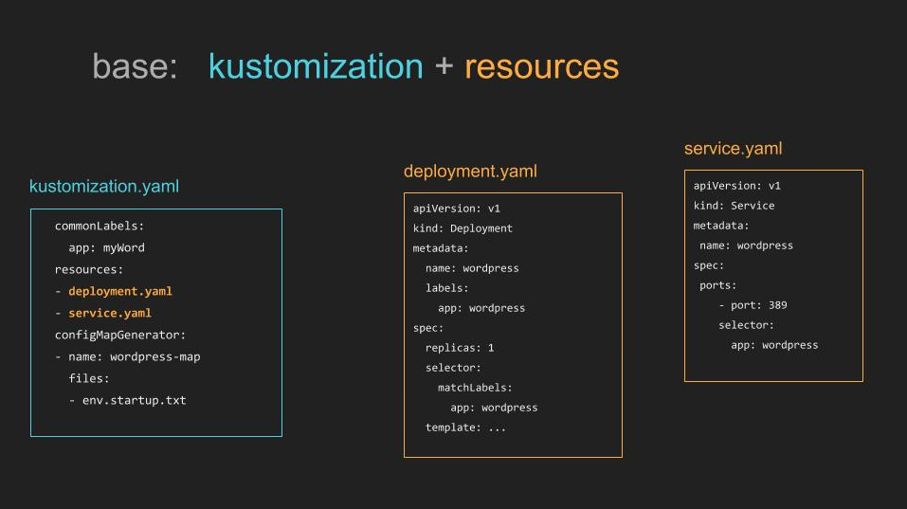
Structure

Slide 6
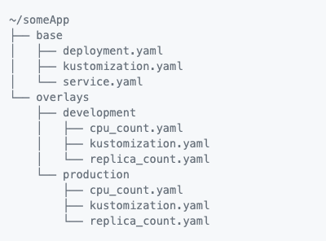
kustomize
kustomize build ~/someApp/overlays/development
kustomize build ~/someApp/overlays/development | kubectl apply -f -
kubectl apply -k ~/someApp/overlays/development
kustomize build ~/someApp/overlays/production
kustomize build ~/someApp/overlays/production | kubectl apply -f -
kubectl apply -k ~/someApp/overlays/production

Slide 7
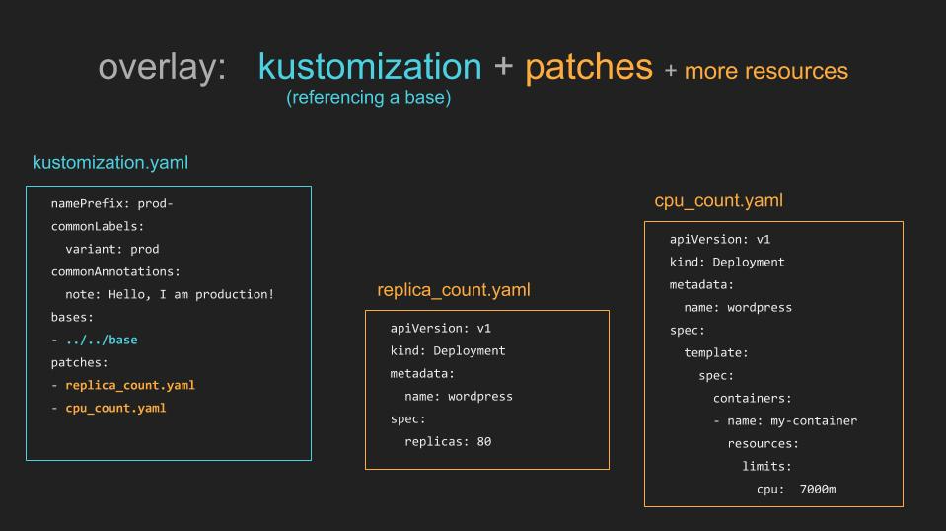
Structure

Slide 8
kustomization.yaml
bases
Add resources from a kustomization dir.
commonAnnotations
Add annotations to add all resources.
commonLabels
Add labels and selectors to add all resources.
components
Compose kustomizations.
configMapGenerator
Generate ConfigMap resources.
crds
Adding CRD support
generatorOptions
Control behavior of ConfigMap and Secret generators.
replicas
Change the number of replicas for a resource.
resources
Resources to include.
images
Modify the name, tags and/or digest for images.
namePrefix
Prepends the value to the names of all resources and references.
namespace
Adds namespace to all resources.
nameSuffix
Appends the value to the names of all resources and references.
patches
Patch resources
patchesJson6902
Patch resources using the json 6902 standard
patchesStrategicMerge
Patch resources using the strategic merge patch standard.
secretGenerator
Generate Secret resources.
vars
Substitute name references.

Slide 9
useful links
kutomize github: https://github.com/kubernetes-sigs/kustomize
documentation: https://kubernetes-sigs.github.io/kustomize/guides/

Slide 10
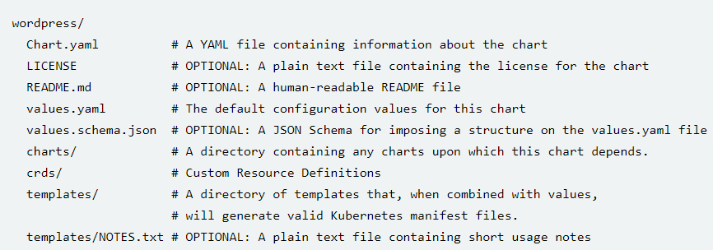
Helm3 – Folder structures
https://helm.sh/docs/topics/charts/

Slide 11
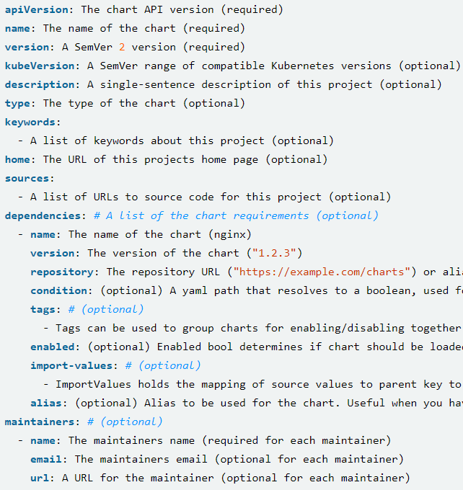
Helm3 – Chart.yaml

Slide 12
Helm3 – template
Helm has over 60 available functions. Some of them are defined by the Go template language itself. Most of the others are part of the Sprig template library.

Slide 13
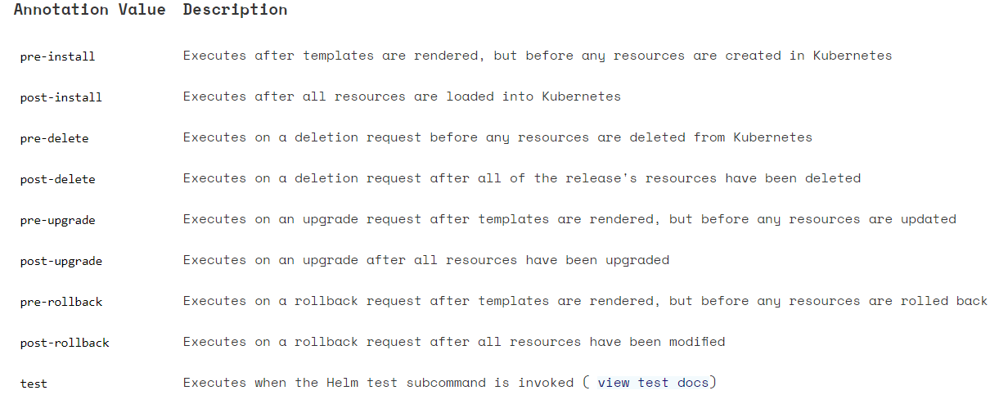
Helm3 – hook

Slide 14


Helm3 – hook
It is possible to define a weight for a hook which will help build a deterministic executing order. Weights are defined using the following annotation:
It is possible to define policies that determine when to delete corresponding hook resources. Hook deletion policies are defined using the following annotation:

Slide 15
Helm3 – sample
Create Schema JOB
Create dependencies Services
Create the service
DB Upgrade Job
Deploy dep svc
Deploy the svc

Slide 16
Kustomize & Helm3
 | Kustomzie | Helm3
Tech | Patch | Template
Maintain effort | Easy | Hard
Learning Curve | Shallow | Steep
Versioning | N | Y
Depends | N | Y

Slide 17
Best practice

